Slide 1
Account CSR Process and Guide
January 2026

Slide 2
Account CSR Process and Guide History
No. | Version | Revision Details | Revision Date
1 | V1.0 | Initial Release | -

Slide 3
Contents
1. Account-Related Inquiries and Ticket Creation Responsibility
1.1 HQ
1.2 Subsidiary
2. Account Processes
2.1 Process by Request Type
2.2 EP Approval Process
2.3 CSR Process (Jira)
[Appendix1] EP Approval Guide
[Appendix2] EP Approver by Account Type
[Appendix3] Jira Access Issue Guide
[Appendix4] CSR Form for System Request
[Appendix5] System Access URL and Guide
[Appendix6] System Account PIC List
[Appendix7] Notes When Requesting a Magento System Account
[Appendix8] Notes When Requesting GP1 M/W

Slide 4
1. Account-Related Inquiries and Ticket Creation Responsibility
1.1 HQ
  Create your own ticket if you have access to LGCOMMON Jira Project
    Account creation and access requests should be submitted by creating a ticket in the LGCOMMON
  Email bu-mgr@lge.com if you do not have access to LG.com 5.0 Common Project
1.2 Subsidiary
  Create your own ticket if you have access to Subsidiary Jira Project
    Subsidiary account requests must be created in each subsidiary’s project, not in the Common project (e.g. Japan subsidiary → create in LG.com GP1 Japan Project)
  If you don’t have access to the subsidiary Jira project, request each country’s CM (Country Manager) to create tickets on behalf of users
Process
EP approval may be omitted for authority change requests.
(For exception systems, refer to the next section)
Check Authority
Register an EP approval
EP approved
Create CSR
Check CSR
Check Account
Request ticket closure
HQ staff without a Jira account → After EP approval, share it with the BU Manager and request ticket creation
Subsidiary staff without a Jira account → After EP approval, share it with subsidiary’s CM and request ticket creation
※ System account request updates
Based on the Personal Information Protection Act and internal system security policies, only EP account and Cloud PC users are allowed to request and use system accounts
  EP account = lge.com or lgepartner.com email account
  LG Electronics employees must request and use system accounts with their lge.com account
  LG Electronics partners must request and use system accounts with their lgepartner.com account (no external email allowed)
LG Electronics employee must first request EP account issuance and apply for Cloud PC for partner staff without an EP account or Cloud PC
Account creation must complete EP approval first

Slide 5
2. Account Processes > 2.1 Process by Request Type
All account creation and access requests must be submitted via Jira CSR after the EP approval has been issued
Refer to the table below for EP approval requirements and details by request type
Request Type | System | EP Approval Requirement | Details
Account Creation | Jira/Confluence | O | For new account (authorization) creation in Jira/Confluence 1) EP Approval → 2) CSR Submission
 | Other LG.com System | O | For new account (authorization) creation in other LG.com System 1) EP Approval → 2) CSR Submission (Refer to Appendix 7 for the Magento system)
 | OMS DB | O | For new account (authorization) creation in OMS DB 1) EP Approval → 2) CSR Submission
Authorization Modification | Jira/Confluence | X | If you already have a Jira/Confluence account but need additional authorization for a specific project Able to skip EP Approval and may submit a CSR directly
 | Other LG.com System | X | If you wish to change the authority on Other LG.com System (e.g. View → View & Edit) Able to skip EP Approval and may submit a CSR directly Provide detailed reasons for adding system authority (Refer to Appendix 7 for the Magento system)
 | OMS DB | O | Proceed with approval for account extension
Account Extension | Other LG.com System | X | If an account for another http://LG.com system has expired and needs to be extended Able to skip EP Approval and may submit a CSR directly Provide detailed reasons for extending account
 | OMS DB | O | If an account for OMS DB has expired and needs to be extended Proceed with approval for account extension Provide detailed reasons for extending account
※ Other LG.com System: AEM, CMS, GP1 Admin, Magento, Coveo, Brightcove, GP1 M/W

Slide 6
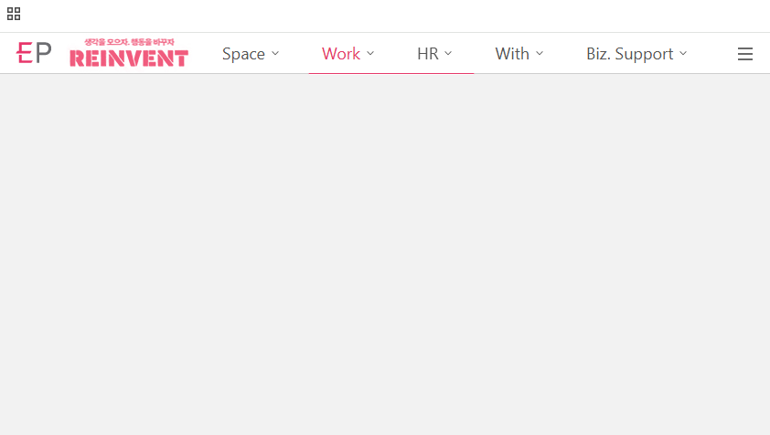
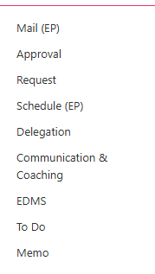
2. Account Processes > 2.2 EP Approval Process (1/4)
Access [EP MAIN] and Login
Click [Work] on upper navigation bar
Click [Request]
1
2
3

Slide 7

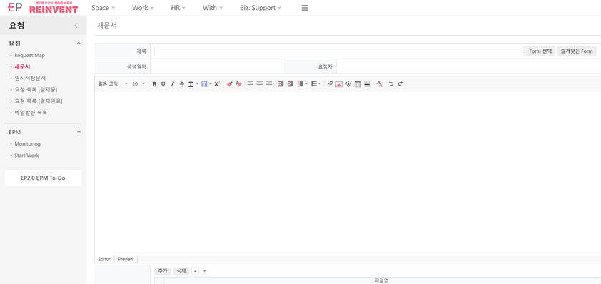


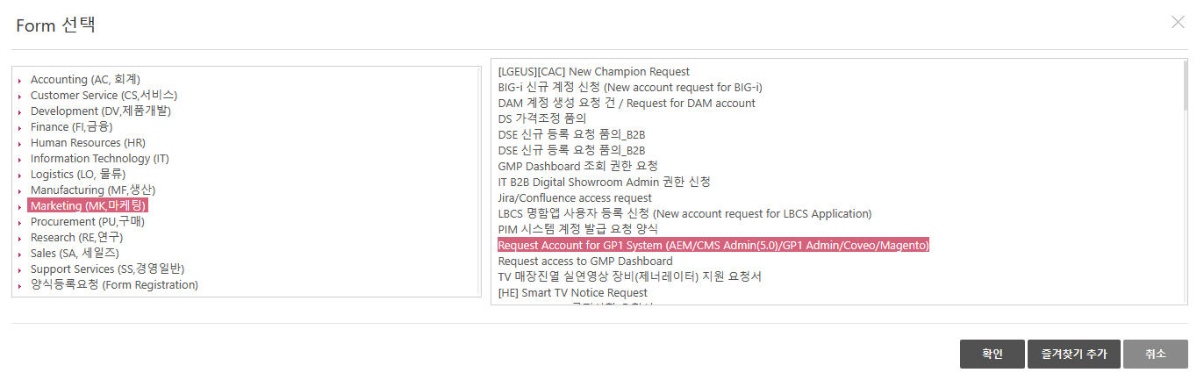
2. Account Processes > 2.2 EP Approval Process (2/4)
Click [Request]
Click [Form]
Select ‘Form 선택’ from popup list
3-1 Click [Marketing(MK마케팅)]
3-2 Select the requesting system
3-3 Click [OK] for the form
2
1
ㅊㅍ
3
3-2
3-1
3-3
Notes:
Change the screen shot in eng ver

Slide 8
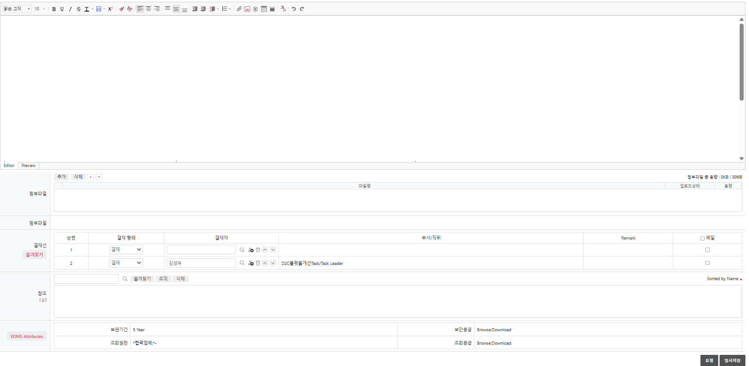
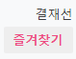

2. Account Processes > 2.2 EP Approval Process (3/4)
1
Fill the form per the EP approval template
Set the approval line according to the requested account
Submit approval via [Request]
For EP, check the requesting system and use the corresponding form -- see Appendix 1
(If the form does not match the requested system, the account cannot be approved.)
How to Write, [Appendix1] for reference
2
EP Approval Line, [Appendix 2] for reference
3

Slide 9
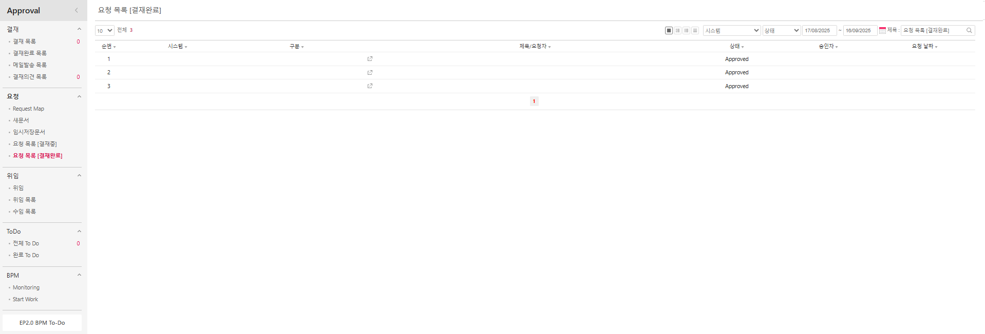
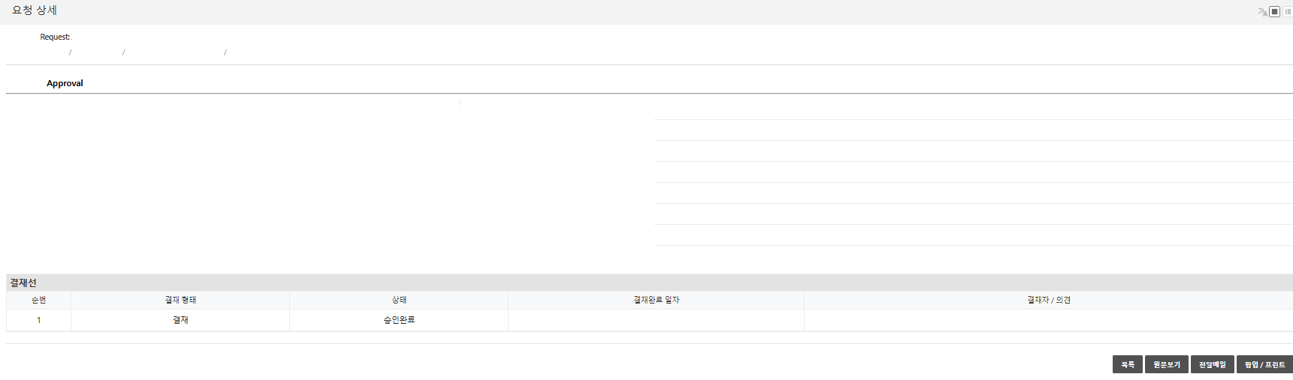
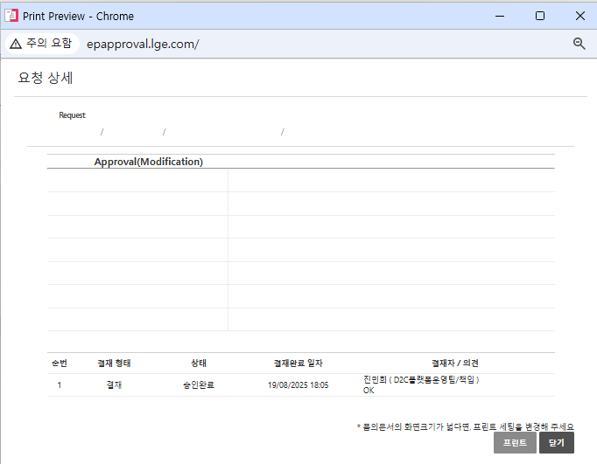
2. Account Processes > 2.2 EP Approval Process (4/4)
Click Request List [Approved]
In request list, click the account item with status “Approved.”
Check approval details in Request Details
Click [Pop-up/Print] to open Pop-up
Click [Print] to save as PDF file
※ Attach the PDF file in Jira CSR
2
1
3
4
5

Slide 10
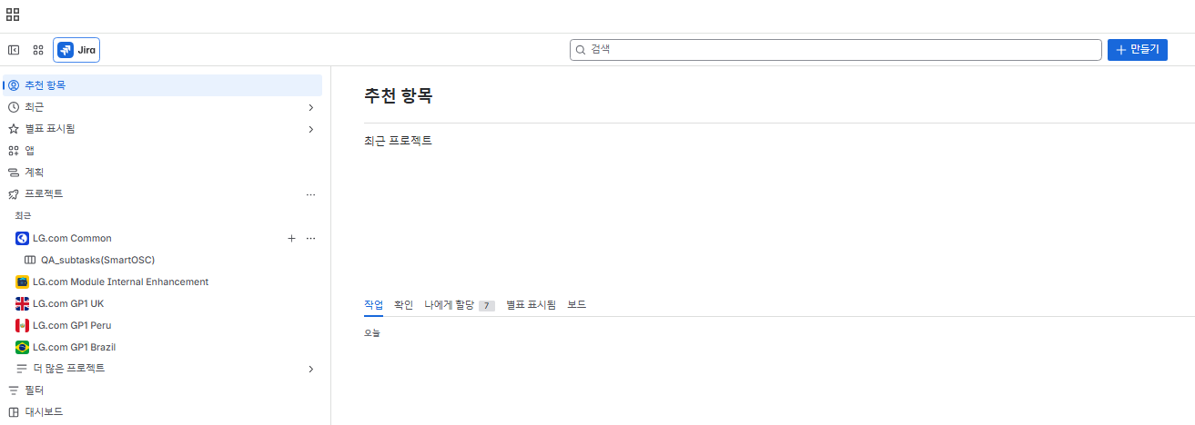
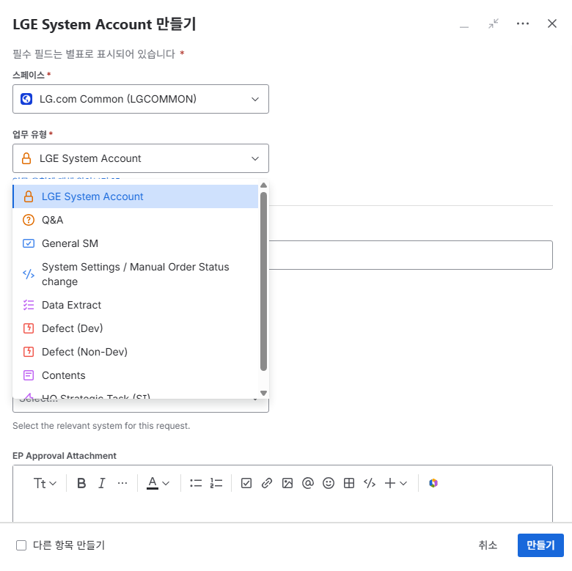
2. Account Processes > 2.3 CSR Process (1/3)
1
Access https://lge-gmc.atlassian.net/
※ An authority issue after access, refer to [Appendix 3]
Click [+Create]
Choose the space the user needs access to
HQ → LG.com Common (LGCOMMON)
Subsidiary → Your subsidiary project
Choose ‘LGE System Account’ in work type
2
3
4
※ 만들기 팝업에서 필수 필드는 별표로 표기되어 있음

Slide 11
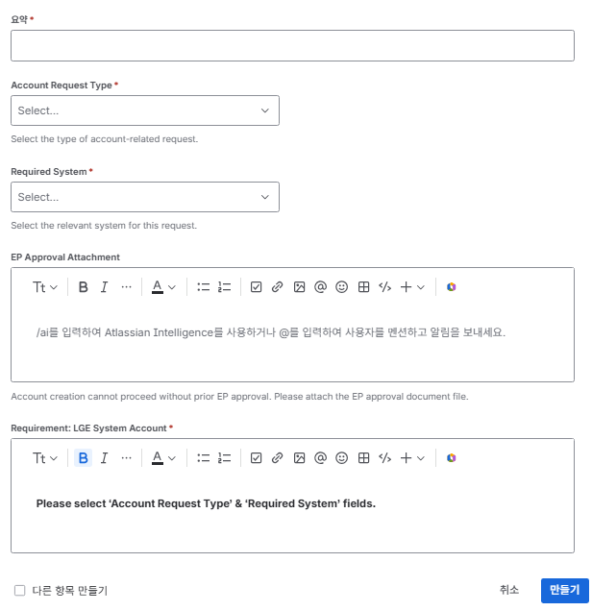
2. Account Processes > 2.3 CSR Process (2/3)
Write requesting title in the summary
Select requesting type in Account Request Type
Select requesting system in Required System
Attach EP Approval
※ Fill in CSR only if no need for EP Approval
Fill the form request in details
Click [Create] for CSR creation
1
Type | Account Request Type
Select | Account Creation (EP Required) Account Renewal /Page Access Account Deletion
2
3
Type | Required System:
선택 | Jira / Confluence AME CMS Admin / GP1 Admin Magento COVEO PIM DAM Adobe Target DB system Brightcove AWS Akamai WhatTap NewRelic GitLab Slack Airflow Grafana Magento Cloud Brightcove
4
5
Fill in Form, [Appendix 4] for reference
6

Slide 12
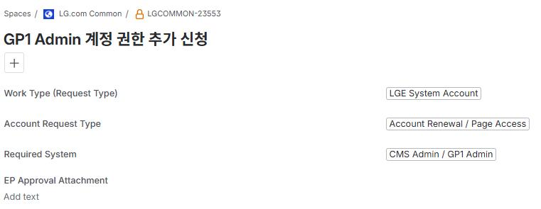
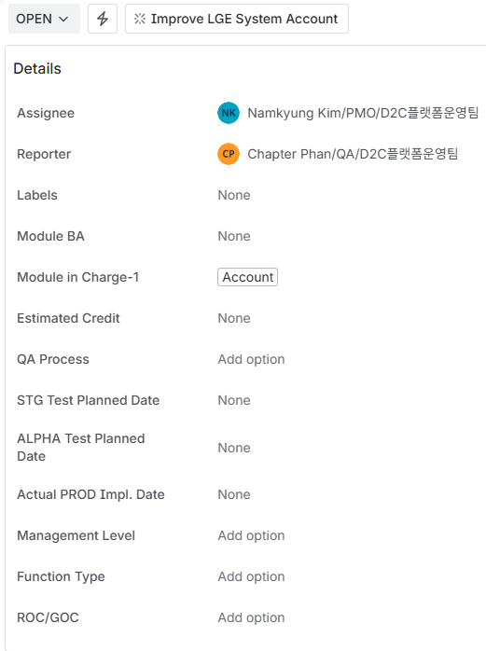

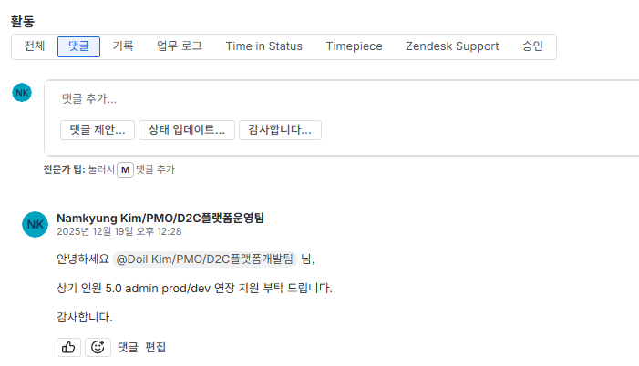
2. Account Processes > 2.3 CSR Process (3/3)
1
Check status of created CSR
Check if status changed to ‘QUALITY REIVEW’, and see comment to check the account for the requested system using the email you received
※ Refer to [Appendix 5] for the system access URL and guide
After checking the account, comment that your account/access has been checked to request for ticket closure
2
Requester
3
2

Slide 13
End of Document
Contacts
D2C BU-Mgr (bu-gmr@lge.com)

Slide 14
[Appendix 1] EP Approval Guide (1/4)
Jira/Confluence
Field Type | Description | Example
Name | Input user’s full name (first name + last name) | David Smith
Name of Company (Agency) | Input the name of the company user is employed | LGE
EP E-mail (Accessible only with EP) | Input your EP E-mail address (Partners use abc@lgepartner.com email *Internal/external users should have EP ID and login under Cloud PC/LGE VPN/LGE office network | Smith.david@lge.com
Purpose of requesting account creation / access | Input the detailed reason for requesting account creation or access to the relevant system | To support on creating and granting account access
Role | Input your specific role (e.g. Developer / BA, TL, etc.)/Task (e.g. Marketing, Digital, etc.) | BU Manager
Authority | Add the authority you need for the system | VIEWER or USER
Locale | Input the locale(s) that user need access | All
Jira Project name / Confluence Space name | Input Jira project name (Code) / Confluence Space name or URL | LGCOMMON / EW Enhancement
Notes:
링크 부분 어떻게 적는 게 좋을 지

Slide 15
[Appendix 1] EP Approval Guide (2/4)
Other LG.com system (AEM/CMS Admin/GP1 Admin/GP1 MW/Coveo/Magento/Adobe Target/Brightcove)
Field Type | Explanation | Example
Name of System | Input the name of the system that user would like account created or access (Select from AEM(GP1 CMS), 5.0 CMS Admin, GP1 Admin, Coveo, Magento, GP1 M/W) | Magento
Name | Input user’s full name (first name + last name) | David Smith
Name of Company (Agency) | Input the name of the company user is employed | LGE
EP E-mail (Accessible only with EP) *Those using an external email must first get EP email and use the EP email to request for an account creation or system access | Input your EP E-mail address (Partners use abc@lgepartner.com email *Internal/external users should have EP ID and login under Cloud PC/LGE VPN/LGE office network ** EP ID(Email) extension needed as it expires every 3 months | Smith.david@lge.com
Purpose of requesting account creation / access | Input the detailed reason for requesting account creation or access to the relevant system | Access required for extract Magento data for tasks
Role | Input your specific role (e.g. Developer / BA, TL, etc.)/Task (e.g. Marketing, Digital, etc.) | BU Manager
Authority *If you are not sure of the type of authority, it will be granted based on the "Role" you input | Add the authority you need for the system | General
Locale *Exclude Magento | Input the locale(s) that user need access | All
Comments | Input any additional comments user would like to state (e.g. Server type: GP1, 5.0 CMS system select from either Prod / Dev) | Prod/STG

Slide 16
[Appendix 1] EP Approval Guide (3/4)
GP1 system (AWS/Akamai/WhaTap/NewRelic/Gitlab/Slack/Airflow/Grafana)
Field Type | Explanation | Example
Name of System | Input the name of the system that user would like account created or access (Select from AWS/Akamai/WhaTap/NewRelic/Gitlab/Slack/Airflow/Grafana) | NewRelic
*Systems related to GP1 will be granted for those countries that are launching; therefore even though you may have received EP approval, GP1 system account may not be issued if your country has not launched GP1
Name | Input user’s full name (first name + last name) | David Smith
Name of Company (Agency) | Input the name of the company user is employed | LGE
EP E-mail (Accessible only with EP) *Those using an external email must first get EP email and use the EP email to request for an account creation or system access. | Input your EP E-mail address (Partners use abc@lgepartner.com email *Internal/external users should have EP ID and login under Cloud PC/LGE VPN/LGE office network ** EP ID(Email) extension needed as it expires every 3 months | Smith.david@lge.com
Purpose of requesting account creation / access | Input the detailed reason for requesting account creation or access to the relevant system | Access required for NewRelic‑related tasks
Role | Input your specific role (e.g. Developer / BA, TL, etc.)/Task (e.g. Marketing, Digital, etc.) | BU Manager
Authority *If you are not sure of the type of authority, it will be granted based on the "Role" you input | Add the authority you need for the system | Developer
Locale | Input the locale(s) that user need access | All
Comments (e.g. Server Type) | Input any additional comments user would like to state (e.g. Gitlab Group name, etc.) | -

Slide 17
[Appendix 1] EP Approval Guide (4/4)
DB system (GP1-OMS/MW DB/ACC/MGR/PIM, 5.0-ACC/MGR/INF)
Field Type | Explanation | Example
Name of System | Input the name of the system that user would like account created or access (Select from (GP1-OMS/GP1-MW/ACC/MGR/PIM, 5.0-ACC/MGR/INF) | GP1-OMS
Name | Input user’s full name (first name + last name) | David Smith
Name of Company (Agency) | Input the name of the company user is employed | LGE
EP E-mail (Accessible only with EP) *Those using an external email must first get EP email and use the EP email to request for an account creation or system access. | Input your EP E-mail address (Partners use abc@lgepartner.com email) *Internal/external users should have EP ID and login under Cloud PC/LGE VPN/LGE office network | Smith.david@lge.com
Purpose of requesting account creation / access | Input the detailed reason for requesting account creation or access to the relevant system | Need DB data to perform and support
Role | Input your specific role (e.g. Developer / BA, TL, etc.)/Task (e.g. Marketing, Digital, etc.) | BU Manager

Slide 18
[Appendix 2] EP Approver by Account Type
Type | Approval #1 | Approval #2
Jira / Confluence | Department manager (LGE representative) | Minhee Jin
Other LG.com system | Department manager (LGE representative) | Hyungwon Park
GP1 system | Sungwoo Kim | -
DB system | Sungwoo Kim | -

Slide 19
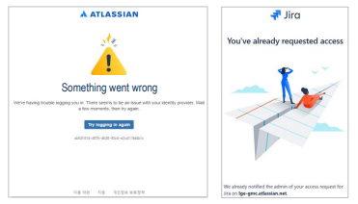
[Appendix 3] Jira Access Issue Guide
Access https://lge-gmc.atlassian.net/ via LGE Cloud PC (Chrome/Edge)
When logging in to Jira, enter your ID with the @lge.com domain, even if you normally use @lgepartner.com (including external partners)
When logging in to Jira, enter your AD Password (when your AD password is changed, your Jira password is automatically updated as well)
→ To change your AD password, send a request by email to spoc@lge.com
If you see an error message like the screenshot below, clear your browser cache and then try accessing Jira again
[Example of an error message]
[How to clear browser cache]
Google Chrome
On your computer, open Chrome.
At the top right, click More Delete browsing data.
Choose a time range, like Last hour or All time.
Select the types of information you want to remove.
Click Delete data.
  * If you delete cookies while signed in to Chrome, Chrome refreshes the Google cookies that keep you signed in. This happens so that Chrome can continue to work as you expect. To delete Google cookies, sign out of Chrome first.
Microsoft Edge
Select Settings and more > Settings > Privacy, search, and services.
Select Clear browsing data, then select Choose what to clear next to Clear browsing data now.
Under Time range, choose a time range from the drop-down menu.
Choose the types of browsing data you want to clear.
→ For example, you may want to remove browsing history and cookies but keep passwords and form fill data.
Select Clear now.

Slide 20
[Appendix 4] CSR Form for Jira Request
Even if it’s in the EP approval, you must write the requirements in the ticket
Jira / Confluence
  Name :
  Name of Company (Agency) :
  EP E-mail (Accessible only with EP) :
  Purpose of requesting account creation / access :
  Jira Space Key :
    (or Description - GP1 Rollout / LG.com GP1 UK / GP1 Rollout AU, etc.)
  Confluence Space Key :
  Project Role :
  Jira Authority :
  Locale :
Notes:
각 시스템별 양식 가이드를 첨부 할 지

Slide 21
[Appendix 4] CSR Form for other LG.com System Request
Even if it’s in the EP approval, you must write the requirements in the ticket
LG.com System - AEM/CMS Admin/GP1 Admin/GP1 MW/Coveo/Magento/Adobe Target/Brightcove
  Name of System :
  Name :
  Name of Company (Agency) :
  EP E-mail (Accessible only with EP) :
  Purpose of requesting account creation / access :
  Server Type (CMS Admin, GP1 Admin Only) : PROD [ ] DEV [ ]
    PROD : General & SM/SI staff , DEV : SM/SI staff
  Project Role :
  System Authority :
  Locale (Magento Excluded) :
  Comments :
Notes:
각 시스템별 양식 가이드를 첨부 할 지

Slide 22
[Appendix 4] CSR Form for GP1 System Request
Even if it’s in the EP approval, you must write the requirements in the ticket
LG.com GP1 System - AWS/Akamai/WhaTap/NewRelic/Gitlab/Slack/Airflow/Grafana
  Name of System :
  Name :
  Name of Company (Agency) :
  EP E-mail (Accessible only with EP) :
  Purpose of requesting account creation / access :
  Project Role :
  System Authority :
  Locale (Magento Excluded) :
  Comments :
Notes:
각 시스템별 양식 가이드를 첨부 할 지

Slide 23
[Appendix 4] CSR Form for DB System Request
Even if it’s in the EP approval, you must write the requirements in the ticket
LG.com DB System - GP1-OMS/MW DB/ACC/MGR/PIM, 5.0-ACC/MGR/INF
  Name of System :
  Name :
  Name of Company (Agency) :
  EP E-mail (Accessible only with EP) :
  CNS E-mail :
  A Employee ID :
  Cloud IP :
  Purpose of requesting account creation / access :
  Project Role :
  System Authority :
  Locale (Magento Excluded) :
  Comments :
Notes:
각 시스템별 양식 가이드를 첨부 할 지

Slide 24
[Appendix 5] System URL and Access Guide
The access URLs and guides for each system are as follows
Name of System | Access URL | Access Guide
Adobe Experience Manager (AEM) | https://experience.adobe.com/ | When an AEM account is created, a login link is automatically sent from message@adobe.com
Product Information Management (PIM) | https://admin.pimds.aws.lge.com/user/login | When a PIM account is created, the login information is automatically sent from lgpim@lge.com
Digital Assets Management (DAM) | author-p86195-e734304.adobeaemcloud.com | Access the system using the DAM Access Guide
5.0 CMS Admin | Prod: https://admin50.cms.LG.com/ Dev: https://dev50.cms.LG.com/ | When a CMS account is created, the login information is automatically sent from customerservice@lge.com
GP1 Admin | Prod: https://admin.gp1.aws.lge.com/ Dev: https://admin.gp1dev.aws.lge.com/ | When a GP1 account is created, the login information is automatically sent from customerservice@lge.com
Coveo (Search) | https://platform-eu.cloud.coveo.com/login | When a COVEO account is created, the login information is automatically sent from donotreply@coveo.com
Magento | 5.0 Magento: https://obs.LG.com/obsadm/admin GP1 Magento: https://shop.LG.com/obsadm | When a Magento account is created, the PIC of account creation sends the login information via email
Jira & Confluence | https://lge-gmc.atlassian.net/Jira | When a Jira/Confluence account is created, the PIC of account creation sends the login information via email
GP1 M/W | https://mw.gp1.aws.lge.com/admin-service/admin/login | When a GP1 M/W account is created, the PIC of account creation sends the login information via email

Slide 25
[Appendix 6] System Account PIC List (1/2)
The PIC of creation/deletion owners for each system are as follows
Name of System | Person in Charge | PIC Email
Adobe Experience Manager (AEM) | Doil Kim | doil.kim@lgepartner.com
Product Information Management (PIM) | Semi Song | semi.song@lge.com
Digital Assets Management (DAM) | DAM Admin | lgdam@lge.com
CMS Admin (5.0) & GP1 Admin | Doil Kim | doil.kim@lgepartner.com
 | Doil Kim | doil.kim@lgepartner.com
Coveo (Search) | Jaejun Han | jaejun2.han@lgepartner.com
Magento | Beonyeol Woon | beomyeol.woon@lgepartner.com
Jira & Confluence | Doil Kim | doil.kim@lgepartner.com
GP1 M/W | Wonseok Jang | wonseok.jang@lge.com
OMS DB | Yeonghun Hyun | yh.hyun@lgepartner.com
※ For account authority questions, contact ps-pmo@lge.com instead of the above system PIC, ※ All LGCOMMON systems are approved by the BU manager

Slide 26
[Appendix 6] System Account PIC List (2/2)
The PIC of creation/deletion owners for each system are as follows
Name of System | Person in Charge | PIC Email
AWS | Myeonggil Yang | mg.yang@lgepartner.com
Akamai | Moongi Jin | moongi.jin@lge.com
WhaTap | Doil Kim | doil.kim@lgepartner.com
Slack | Doil Kim | doil.kim@lgepartner.com
NewRelic | Jihwan Kim | jiwhan.kim@lgepartner.com
Gitlab | Hyuk Kang | hyukkang.kang@lgepartner.com
Airflow | Doil Kim | doil.kim@lgepartner.com
Grafana | Doil Kim | doil.kim@lgepartner.com
Brightcove | Doil Kim | doil.kim@lgepartner.com
※ For account authority questions, contact ps-pmo@lge.com instead of the above system PIC, ※ All LGCOMMON systems are approved by the BU manager

Slide 27
[Appendix 7] Notes When Requesting a Magento System Account
EP Approval/CSR submission criteria
EP Approval submission:
  The requester must submit the EP directly and get approval; proxy submission is not allowed
  (The requester info in the EP must match the EP email.)
  Unlike other systems, EP for Magento/Magento Cloud must be submitted for that system only
CSR Requests:
  A proxy may proceed by attaching the requester’s EP approval
  If multiple accounts are requested, attach a separate EP for each account
  e.g.) One person can submit a CSR for four new Magento accounts, but must attach four EP approvals, one per requester
For higher or changed authority
  The requester must get EP approval, then submit a CSR
For Magento/Magento Cloud, EP is required even for authority changes
At initial account creation, everyone is given General permission only
For any additional authorities, get EP approval for the change, then submit a CSR

Slide 28
[Appendix 8] Notes When Requesting GP1 M/W
GP1 M/W System Account Creation Process
Sign in Middleware Admin
Website
Create CSR
Account creation and grant authority by PIC
Proceed Log in
→ PROD
→ DEV
→ Attach screenshot of EP Approval
→ Log in with the temporary password sent by email, then change your password before use

